Slide 1
Mobile Applications
Group 48 - Campus Event App

Slide 2
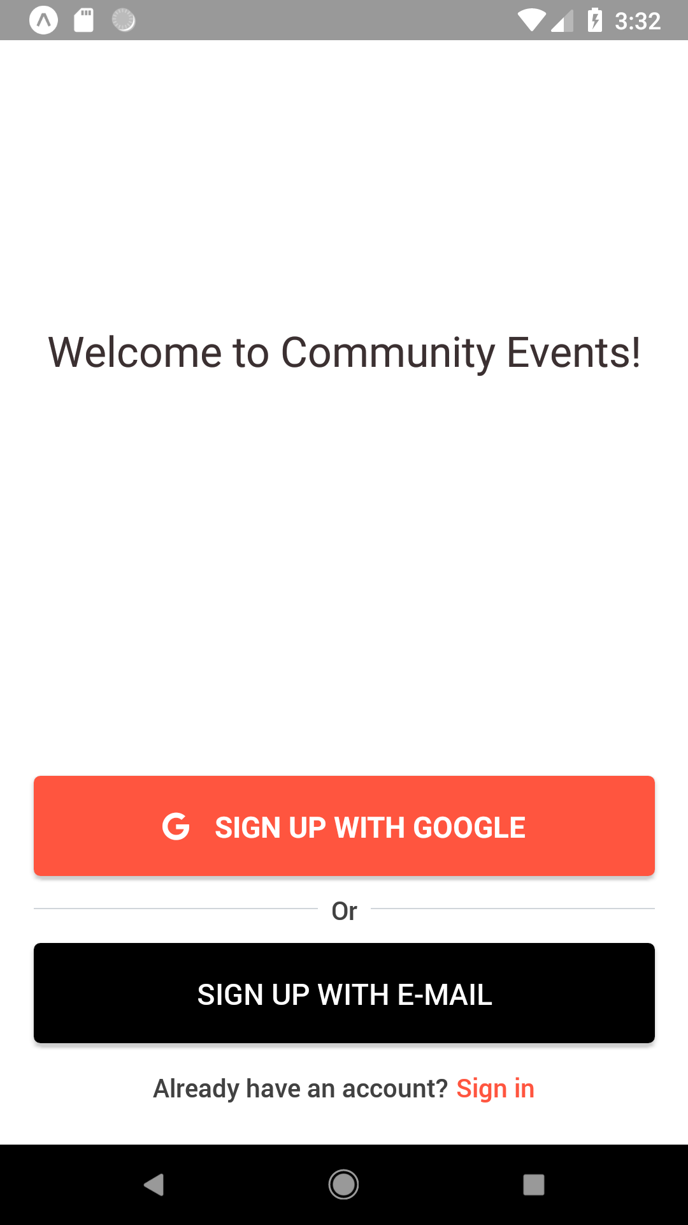
Current progress of project
Secure Login
Back End
Redux to store application’s states
Welcome screen: right pics

Slide 3
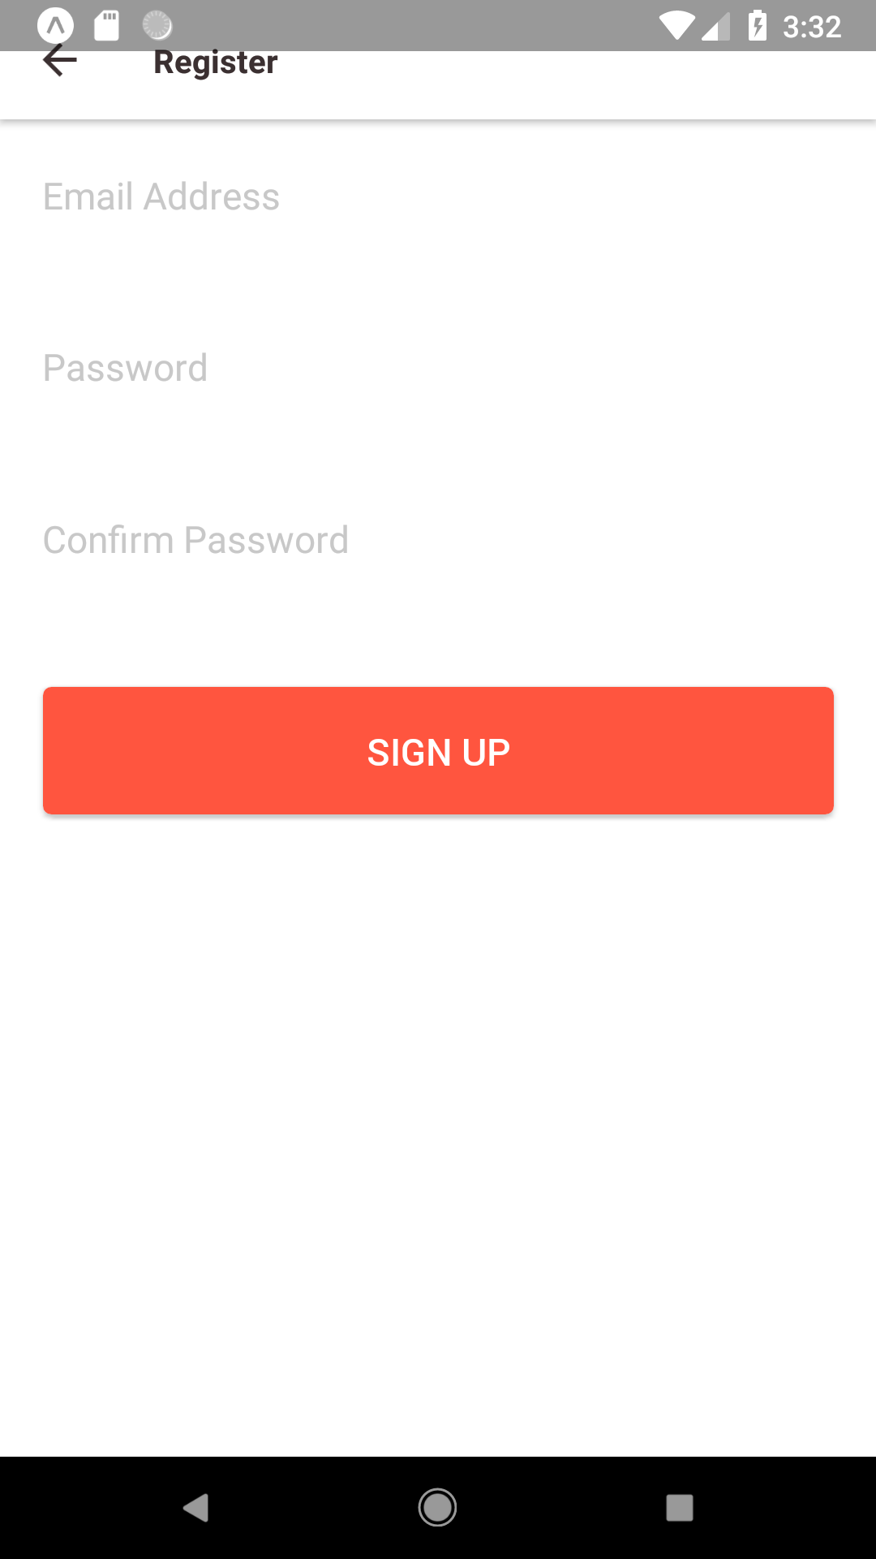
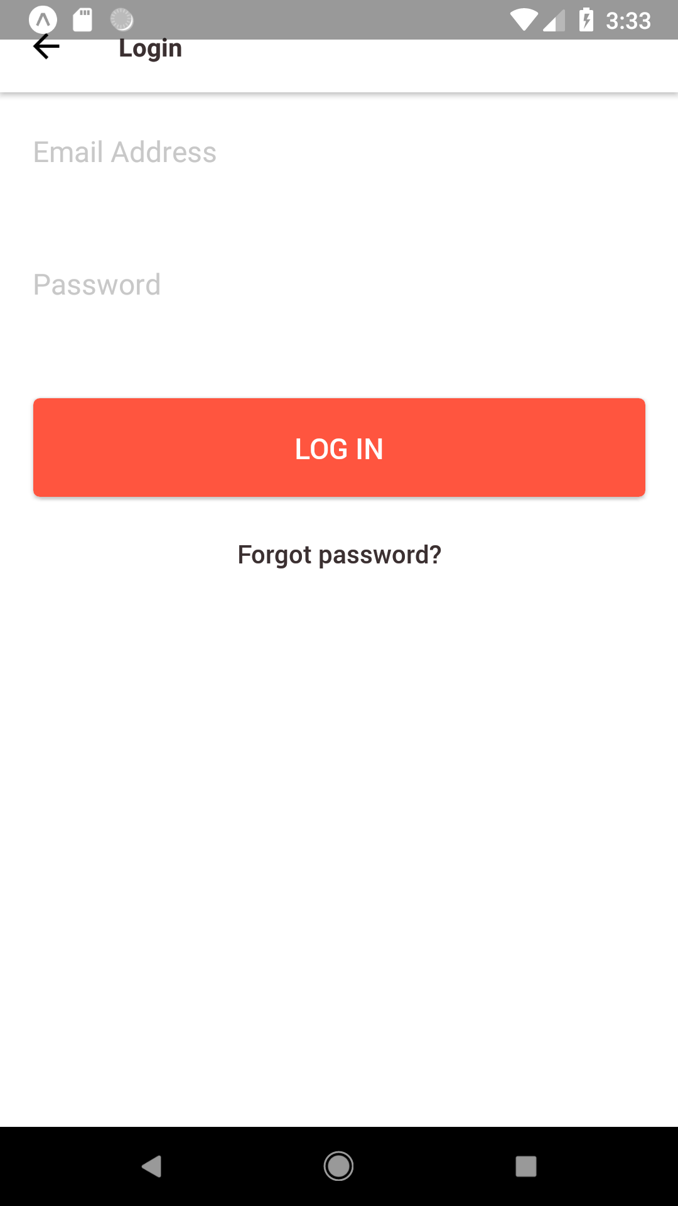
Current progress of project(continue)
Front End
Sign up and Login pages: left pics
CompleteProfile page allow user set user name
ForgetPassword allow user to reset password

Slide 4
The works that need to be done
Retrieve data from Firebase realtime database
Stretch goals: notification push

Slide 5
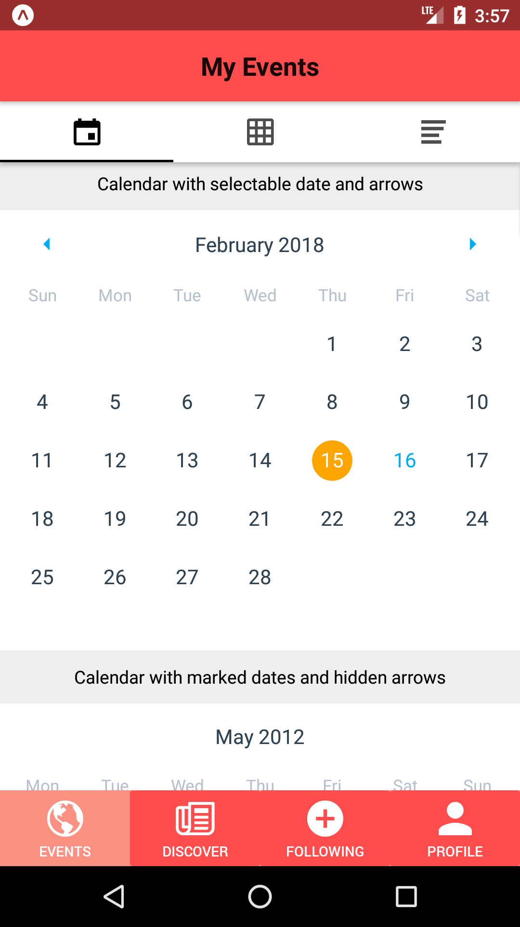
Problems encountered
No experiences for using React Native
No experiences for NoSQL database

Slide 6
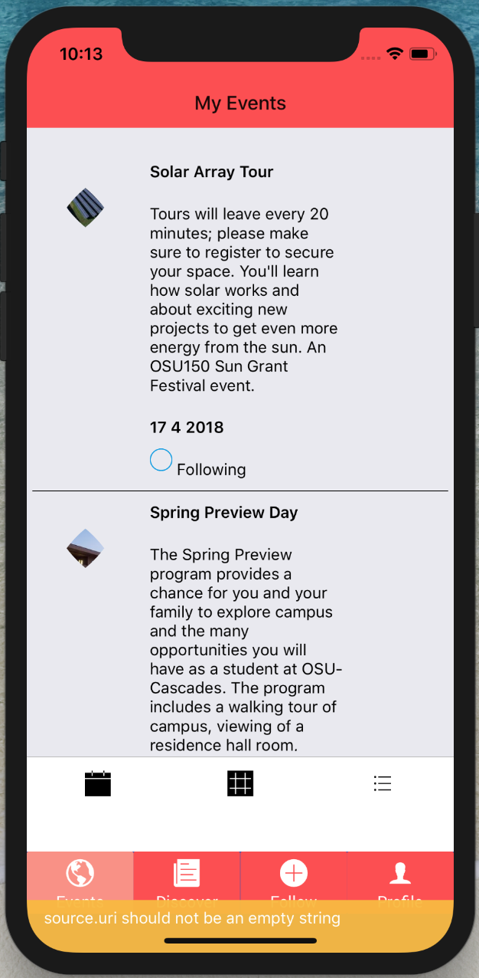
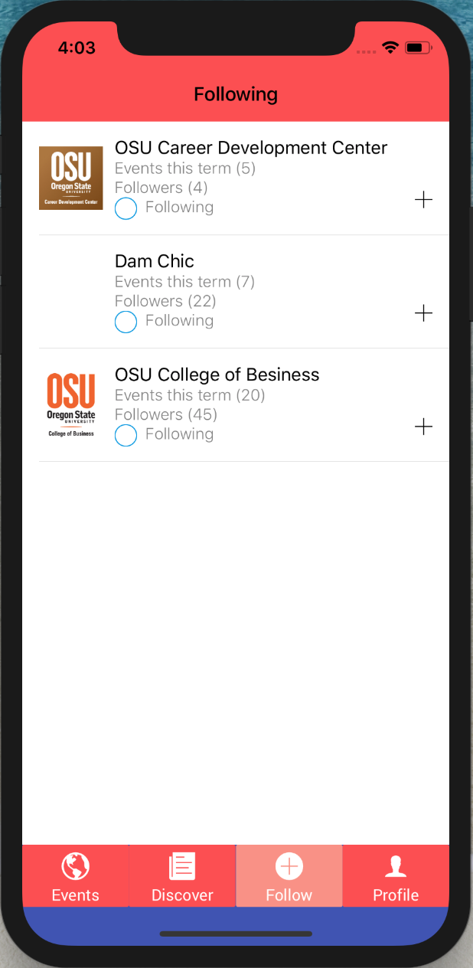
Current progress of project
Almost finish the secure login
Using dummy data for testing
Follow page

Slide 7
What’s left
Implement the notification push
Fixing bugs i.e. the IOS platform bottom
Preparing for EXPO

Slide 8
Problems
Data from OSU which we could not use
Combining the files of code

Slide 9
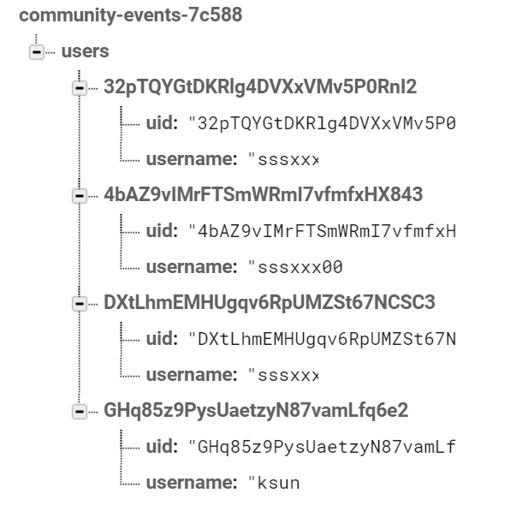
Current Progress
NoSQL
Firebase Realtime Database
Learning the structure

Slide 10
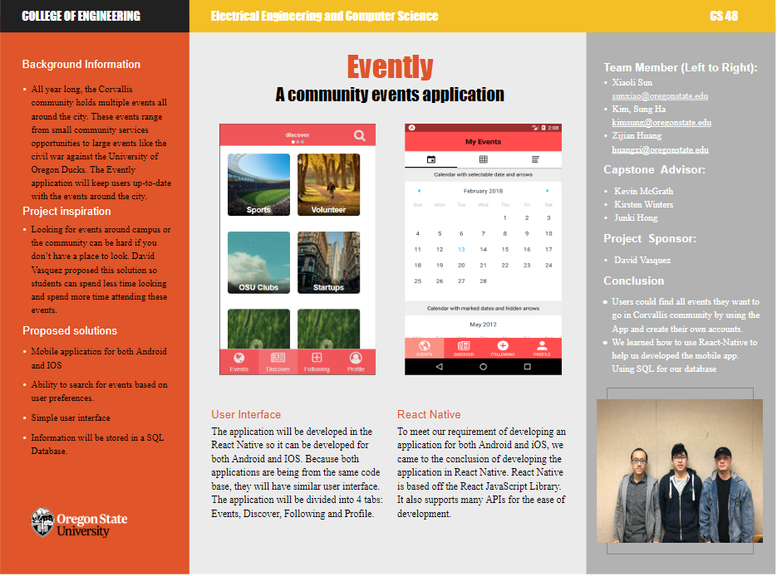
Current Progress
Getting ready for expo
Paperwork
Poster

Slide 11
What’s Left?
Clean up the application
Place more dummy data into the database

Slide 12
Problems and Issues
Switched to a NoSQL DB after implementing login
Bad and good
Still no real data to play with

